Slide 1


Sales Analysis App Python Project
Paper Airplanes
Women in Tech Program
Presented by: Ghinwa Allaoui, Kinda Reyes and Riam Abbas
Tutor: Mulham Fetna
Mentors: Jaspreet Kaur and Mohammad Mujtaba

Slide 2

🌿 To Every Woman Who Believes in Her Power to Create Change 🌿 This project is more than just data and numbers It’s a journey to discover our capabilities and affirm our place in a fast-evolving world We analyze to understand, understand to design, and design to make a real impact The continuity of our struggle is proof of our inevitable existence

Slide 3
Project Objectives and Goals
Key Objectives;
Develop an interactive sales analysis tool, accessible to non-technical users.
Enable data-driven and decision-making for small and medium businesses.
Identify key drivers of product performance through visual analysis.
Measurable Goals;
Build a user-friendly interface requiring minimal training.
Support multiple data formats and flexible data structures.
Deliver actionable insights to improve profitability.
Incorporate sustainability metrics into business performance analysis.

Slide 4
Problem Statement and Proposed Solution
Problem Statement
Small businesses struggle to extract meaningful insights from sales data.
Complex analytical tools require technical expertise.
Sustainability metrics are often overlooked in business analysis.
Decision-making is frequently based on intuition rather than data.
Proposed Solution
An interactive online dashboard with an intuitive interface.
Automated visualization of key performance indicators.
Built-in sustainability analysis capabilities.
No programming knowledge required for users.
Target Audience
Small and medium-sized business owners.
Retail managers and sales teams.
Product developers and marketers.
Sustainability-focused organizations.

Slide 5
What Makes Our Solution Unique
Feature
Easy to Use
Sustainability Focus
Flexibility
Accessibility
Customization
Our Solution
Simple upload-and-click interface
Integrated eco-friendly analysis
Works with diverse data formats
Free, open-source web app
Multiple analysis types in one tool
Competitors
Often requires technical setup
Rarely included
Often requires specific formats
Many require subscriptions
Usually specialized tools
“Our focus on combining business metrics with sustainability analysis creates a unique value proposition for modern, conscious businesses”

Slide 6
Methodology
Development Approach
User-Centered Design
Began by assessing user needs
Iterative development with feedback loops
Agile Implementation
Six-week development cycle
Weekly sprints with defined deliverables
Data Processing Strategy
Automated data cleaning and preprocessing
Flexible data input system
Focused on intuitive interface design
Continuous testing and improvements
Focused on visualization instead of complex statistics

Slide 7
Technologies Used Tech Stack
Frontend and Visualization:
Data Processing:
Streamlit for the interactive web interface.
Plotly for interactive charts.
Matplotlib for static visualizations.
Python as the core programming language.
Pandas for data manipulation.

Slide 8
Key Features; Data Input and Exploration
Data Input:
Support for both CSV and Excel formats.
Automatic detection and cleaning of columns.
Identification of missing data with clear error messages.

Slide 9
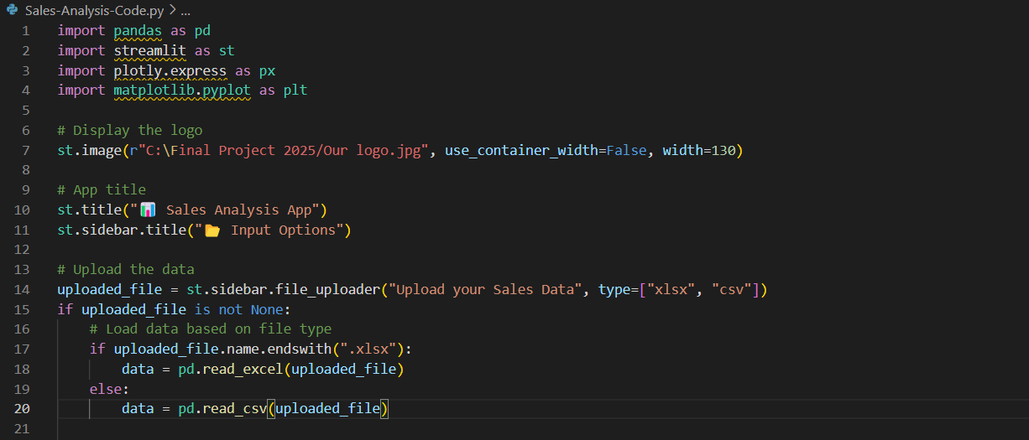

Slide 10
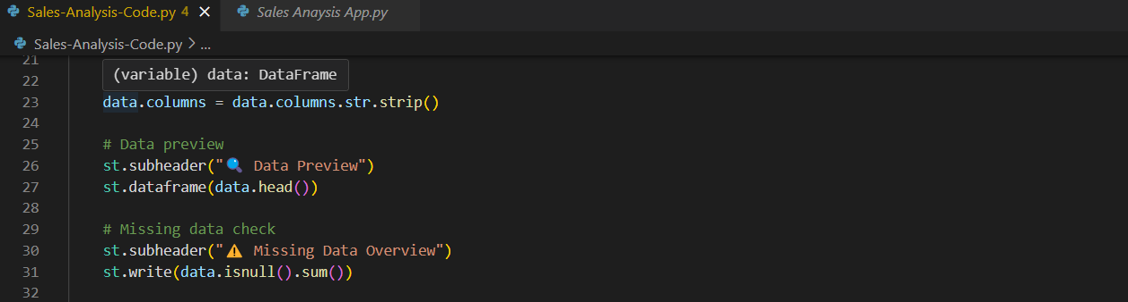

Slide 11
Key Features; Analysis Options Available
Sales by Store Location:
Bar chart showing total sales across different locations.
Top 5 Selling Products:
Ranking of the top 5 best-selling products.
Product Distribution (Pie Chart):
Pie chart comparing different product types in your dataset.
Eco-Friendly Analysis:
A pie chart showing the usage of eco-friendly cups or similar metrics.
Price vs. Quantity Sold:
Scatter plot analyzing the relationship between price and quantity sold.
Price Distribution:
Histogram of unit prices to explore pricing trends.

Slide 12
Key Features Revenue Analysis
Revenue Calculation:
Automatic Revenue Metrics:
Revenue is calculated as: Unit_price × Transaction_qty.
Revenue by Product:
Bar chart displaying revenue breakdown by product type.
Profitability Insights:
Identify high-performing and low-performing products.

Slide 13
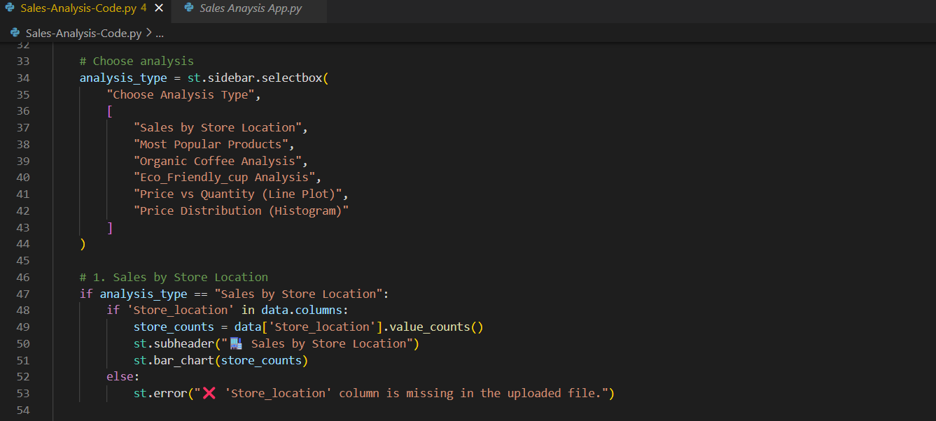

Slide 14
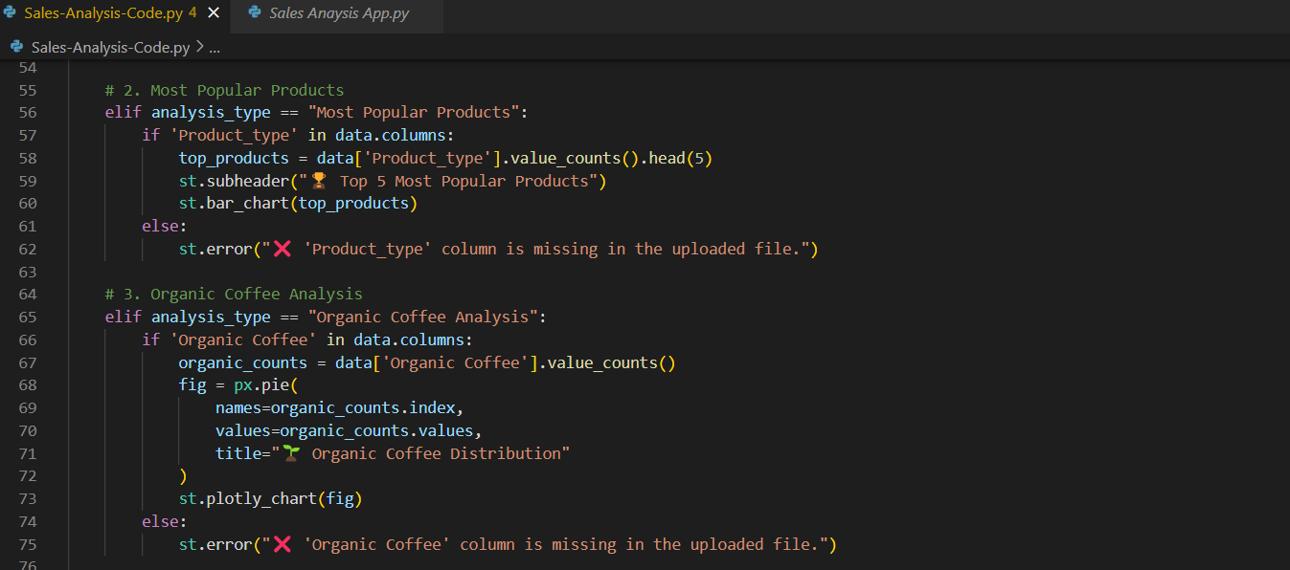

Slide 15
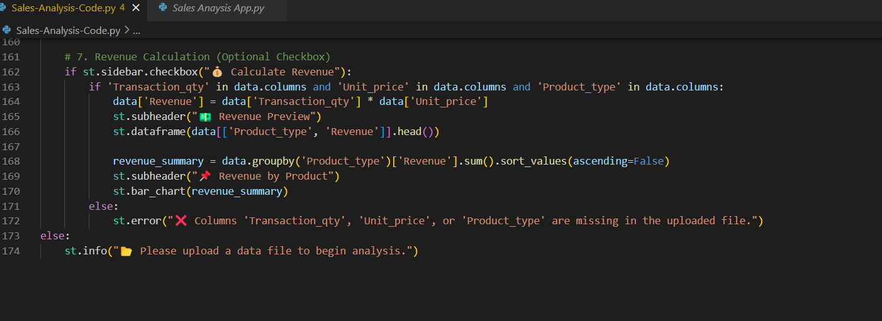

Slide 16
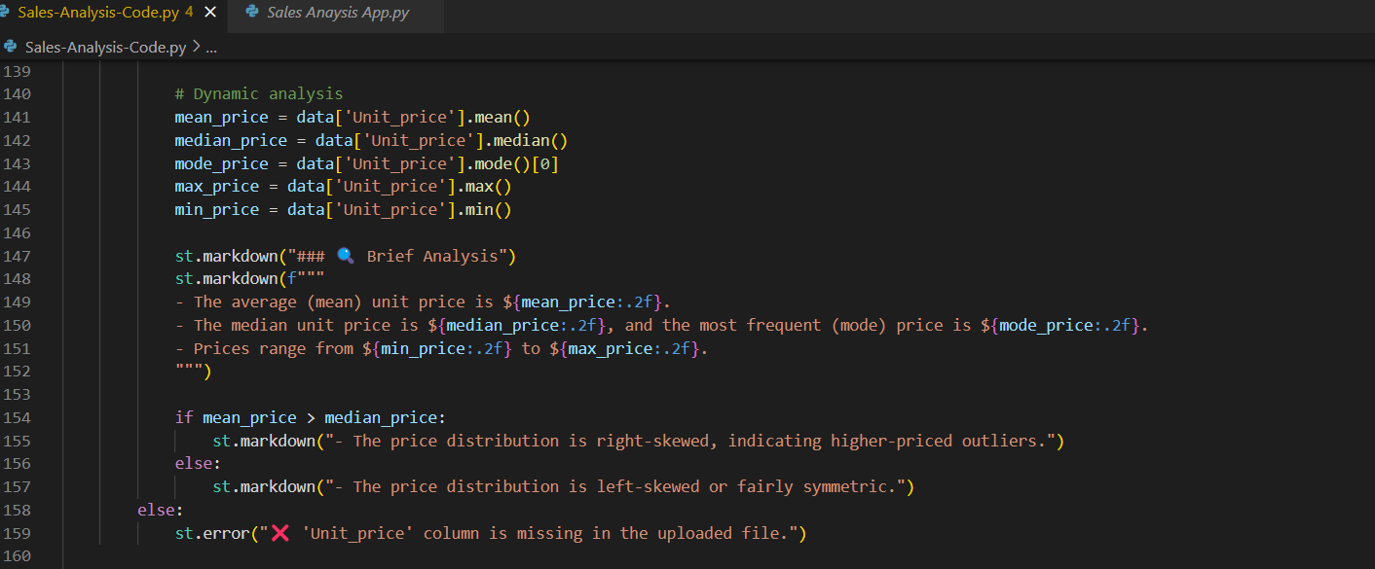

Slide 17
Challenges and Solutions
Technical Challenges:
Solutions:
Handling diverse data formats and structures.
Creating responsive visualizations for different screen sizes.
Flexible column mapping and data type detection.
Responsive design capabilities using Streamlit.

Slide 18
Social and Environmental Impact
Social Impact:
Environmental Impact:
Empowering Small and Medium Businesses:
Affordable tool for data analysis without advanced technical resources.
Promotes data-driven decisions to enhance performance.
Education and Learning:
Provides an opportunity to learn and acquire data analysis and Python programming skills.
Encouraging Sustainability:
Integration of metrics like organic coffee analysis and eco-friendly cup usage.
Highlights the importance of sustainable products for businesses and customers.
Reducing Waste:
Helps businesses optimize inventory management and minimize waste.

Slide 19
Work Plan or Future Roadmap
Short-Term Enhancements
Long-Term Vision
Add New Features:
Support exporting reports and graphs in multiple formats.
Improve user interface for greater appeal and ease of use.
Increase Compatibility:
Enhance support for various data formats.
Optimize performance for resource-limited devices.
Incorporating Artificial Intelligence:
Implement machine learning for sales prediction.
Add a recommendation engine to enhance sales strategies.
Platform Expansion:
Develop a mobile app for on-the-go data analysis.
Integrate with inventory management systems (ERP).

Slide 20
Conclusion and Lessons Learned
Project Summary:
The Sales Analysis App represents a significant step in simplifying data analysis for businesses.
Empowers users to make data-driven decisions and achieve sustainability.
Achievements:
Developed a flexible and user-friendly tool.
Identified key drivers of product performance.

Slide 21
Lessons Learned
Technical Development:
Gained skills in using Python libraries like Pandas, Streamlit, Plotly, and Matplotlib.
Learned how to design an interactive user interface.
Project Management:
Importance of pre-planning and dividing tasks into smaller steps.
Dealing with technical and managerial challenges positively.
Collaboration and Teamwork:
Enhanced teamwork and effective communication skills.

Slide 22
References
Streamlit: https://streamlit.io/
Pandas: https://pandas.pydata.org/
Matplotlib: https://matplotlib.org/
Plotly: https://plotly.com/python/

Slide 23
